Slide 1
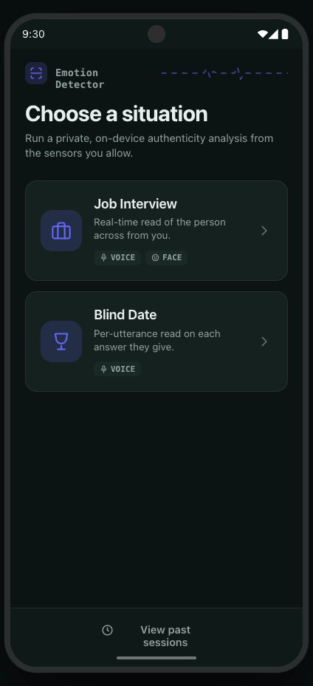
ON-DEVICE · VOICE · FACE · PPG
Emotion and Deception
Detector
A private, on-device system that reads emotion and deception by fusing voice, facial expression, and heart-rate signals
VOICE
FACE
PPG
DECEPTION
MCA · Final Presentation
준병 · 재웅 | May 2026
Notes:
Emotion Detector is an on-device Android app that reads whether what a person says matches what their body reveals. Two things to keep in mind as we go: everything runs locally with no cloud, and the system is split into two interaction modes — a Job Interview mode and a Blind Date mode — that use slightly different sensor and model combinations. I'll point out where our implementation differs from the original plan as we move through the deck.

Slide 2


01
GOAL & USAGE SCENARIO
Authenticity, read in real time
The goal: an on-device application that acts as a lie & emotion detector, surfacing whether what a person says matches what their body reveals.
Job Interview
Blind Date
Capture the person's face.
Voice and facial expression are read continuously as they answer.
The other person rests a fingertip over the rear camera and flash. We pair that fingertip pulse with their voice for a continuous genuine / fake read.
VOICE
FACE
VOICE
PPG
02
Notes:
Two usage scenarios. In Job Interview mode you can point the camera at the person, we read their voice and facial expression continuously.
For example in settings like a video interview, you could leave the camera pointed at the screen and read emotion from their voice and facial expressions.
In the second scenario, such as a Blind date, the other person rests a fingertip on the rear camera and flash.
This will give a real fingertip PPG signal, and by combining it with ther voice, we can continuously read whether they're genuine or fake
Note the change here: we originally planned to also pull heart rate from the face with rPPG, but we did not implement facial rPPG — so Interview mode is voice plus face only. In Blind Date mode the other person rests a fingertip on the rear camera and flash; that gives us a real fingertip PPG pulse signal, which we combine with their voice. So PPG is still in the project — it just lives in Blind Date as a fingertip sensor, not as a contact-free facial reading.

Slide 3


02
KEY IDEA
Two pillars: per-signal models, a sensing app
The Model
The Application
Per-signal models, combined per scenario rather than one end-to-end fused net.
An Android app that senses live signals and runs inference fully on-device.
What it senses — microphone, camera, and fingertip PPG heart-rate.
How it serves — sliding-window inference, no network round-trip.
How it is trained — per-modality models on labelled affect data.
How it is combined — voice+face for Interview, voice+fingertip-PPG for Blind Date.
03
Notes:
Two pillars: the model side and the application side. On the model side — rather than one giant fused network, we trained per-signal models and combine the relevant ones per scenario.
In Detail, we use a log-mel spectrogram(voice data) and a face image as input. Each goees through a CNN backbone into a feature map, and then a small head on top predicts emotion or veracity. We built these per modality - a voice model, voice-ppg model and a face model.
The app just pick the right ones per scenario
The voice branch takes a log-mel spectrogram into a CNN;
the face branch takes a cropped face image into a CNN;
and for Blind Date we add a fingertip-PPG branch.
On the application side, From ic and rear camera, we senses fingertip PPG and camera, microphone
and infers with sliding-window technique.
The key correction versus our proposal: PPG is fingertip-based, and there is no single end-to-end fusion model — it's modality models assembled per mode.

Slide 4
03
KEY IDEA · MODEL
Trained per signal, read per scenario
Job Interview
NO PPG
Blind Date
+ FINGERTIP PPG
VOICE
→
EMOTION HEAD
VOICE + FINGERTIP PPG
→
EMOTION HEAD
Mel spectrogram → CNN
8-class
Voice Mel spectrogram + PPG pulse → CNN / 1-D
8-class
VOICE
→
VERACITY HEAD
VOICE + FINGERTIP PPG
→
VERACITY HEAD
Mel spectrogram → CNN
genuine / fake
Voice Mel spectrogram + PPG pulse → CNN / 1-D
genuine / fake
FACE
→
EMOTION HEAD
96×96 crop → CNN
8-class
App compares face vs voice emotion side by side + a Face–Voice mismatch score; the voice model drives the deception gauge.
App outputs a continuous genuine / fake read plus the dominant emotion.
04
Notes:
> Here's the model side in detail.
Every model follows the same shape: an input — a log-mel spectrogram for voice, or a 96×96 face crop — goes through a CNN backbone that produces a feature map, and a small head on top reads that feature for one task.
We split the heads by task, so one head predicts 8-class emotion (angry, contempt, disgust, fear, happy, neutral, sad, surprise) and other head predicts veracity — genuine versus fake.
We built these per modality , which gives us five models in total. Different from out first plan, there is no feature-fusion network due to its accuracy. Each model runs independently, and we combine their outputs at the app level, per scenario: Job Interview runs voice→emotion, voice→veracity, and face→emotion, then shows the face and voice emotions side by side with a face–voice mismatch score; Blind Date runs the voice+fingertip-PPG emotion and veracity models for a continuous genuine/fake read.
(이 내용은 뒤에서)
Two notes for accuracy: the voice mel is generated with the exact same preprocessing as training (librosa-equivalent log-mel, n_fft 2048, hop 1024, Slaney filterbank, dB, per-window z-score)

Slide 5




04
KEY IDEA · APPLICATION
Voice, face, and a fingertip pulse
Voice
Face
Fingertip PPG
Microphone captures prosody & tremor
Take the most recent 5-second window (2.5 stride)
Convert it into a log-mel spectogram
Same transform used in training
(n_fft 2048, hop 1024, per-window z score)
Camera detects the face and crops it (96×96) to read the surface emotion being shown.
Used ML Kit face detection to find the face box
Heart rate from a fingertip resting on the rear camera and flash — a red-channel pulse extracted from the live frames.
Privacy by design. All three streams are processed and discarded on the device — nothing is uploaded or stored off-phone.
05
Notes:
Three sensing channels, all on-device. Voice from the microphone — prosody and tremor. And the microphone audio isn't fed to the model raw: we keep a rolling buffer and take the most recent 5-second window (a sliding window with a 2.5-second stride), convert it into a log-mel spectrogram — the exact same transform used in training (n_fft 2048, hop 1024, Slaney mel, dB, per-window z-score) — and that spectrogram is what goes into the voice model. We run that mel front-end with an FFT on-device so it's fast enough to keep up in real time. Face from the camera — but here's a change: instead of facial landmark or mesh tracking, we use ML Kit face detection to find the face bounding box, then crop that region to 96×96 for the emotion model. And fingertip PPG — the third card used to say "PPG & rPPG" with contact-free facial reading; that was a misconception on our part. In reality the pulse comes from a fingertip resting on the rear camera and flash, and we extract the heart rate from the red-channel variation across frames. There is no facial rPPG. Privacy by design still holds — all three streams are processed and discarded on the phone.

Slide 6
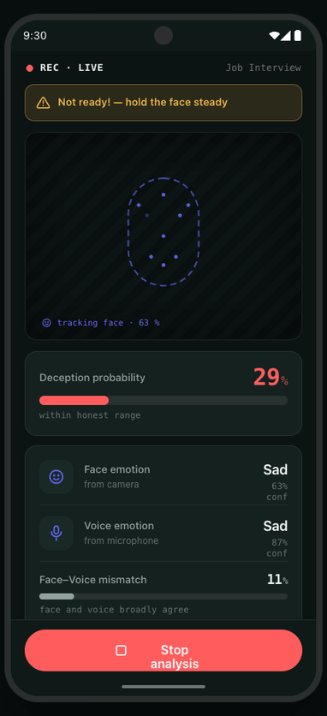
05
APP FUNCTIONALITY
Two inference modes, one live read-out
VOICE + PPG
Blind Date mode
Lightweight: a fingertip pulse lock plus the mic, giving a continuous genuine / fake read and emotion.
CAMERA + VOICE
Interview mode
Face emotion and voice emotion combine into a live deception gauge plus a face–voice mismatch indicator.
LIVE GAUGE
TELL-TALE
SURFACE
Deception %
Face–Voice mismatch
Emotion + conf.
06
Notes:
Two inference modes sharing one live read-out. Blind Date is the lightweight one: a fingertip pulse lock plus the mic, giving a genuine/fake read. Interview is camera plus voice — and note it does not use PPG anymore
the live deception gauge, recent window's fake-class probability is driven by the voice veracity model, and we additionally show the face emotion and the voice emotion side by side, plus a face–voice mismatch score. We use the consine distance between the two emotion distributions(voice and face) as the tell-tale signal.
A heart rate via fingertip PPG only appears in Blind Date.
Also, both veracity model infer on a 5-second sliding window with a 2.5-second stride, matching how the model was trained.

Slide 7
06
APP FUNCTIONALITY · INFERENCE
Sliding window & fingertip PPG lock
Sliding-window inference
Fingertip PPG lock policy
Continuous signals are sliced into overlapping windows, so a verdict updates every step instead of waiting for the clip to end.
A policy gates when the pulse is sampled — only while the fingertip covers the lens and the red channel is stable.
RUN Finger covers the lens, red channel stable → sample PPG, refresh BPM.
HOLD Finger lifts or signal noisy → reuse last stable BPM.
WARN No pulse lock → prompt the user to place a fingertip.
5 s
2.5 s stride
t
07
Notes:
On the left, sliding-window inference: we slice the continuous voice into overlapping 5-second windows with a 2.5-second stride, so the verdict refreshes roughly every step instead of waiting for the
person to finish.
That window size is exactly what the model was trained on. On the right, the fingertip-PPG sensing policy.
We only trust the pulse when the finger is actually covering the lens and start the inference.
when the red-channel signal is steady we lock on and refresh the BPM.
The BPM itself is computed from peak-to-peak intervals, smoothed with a 10-second median so the number stays stable instead of jumping every frame.

Slide 8


07
BEFORE / AFTER OPTIMIZATION
Pruning
Quantization
Remove low-importance weights / channels to cut compute with minimal accuracy loss.
Shipped as float16 TFLite (FP32 → FP16, 2× smaller); swap to INT8 figures only if measured.
Shrinking the model to fit the phone
Quantization and pruning applied to 3 models.
Original TFLite models retained for 2 models to preserve accuracy.
08
Notes:
Optimization to fit the phone. Two levers: pruning to drop low-importance weights, and quantization to shrink and speed up the math. One accuracy note specific to our build: the shipped TFLite models are float16-quantized. If we present INT8 numbers, make sure the table matches what we actually measured. Also worth mentioning: a real-time bottleneck we hit was the spectrogram, not the model — a naive DFT blocked the audio thread, so we switched the mel front-end to a radix-2 FFT, which is what made live windows actually appear. Fill the table with our measured size, latency-per-window, peak memory, and accuracy before and after.

Slide 9
08
DEMO
See it run
09
Notes:
Live demo. Three things to show: in Interview, the camera preview with the ML Kit face-detection box drawn live, plus the face emotion and voice emotion read out together with the face–voice mismatch gauge. In Blind Date, the fingertip PPG lock and the stabilized BPM. And on the Result screen, the emotion timeline heatmap — eight emotion rows across the session's sliding windows, with the dominant emotion per window highlighted. If the lie score looks flat, that's expected — call out that emotion is the stronger signal.

Slide 10
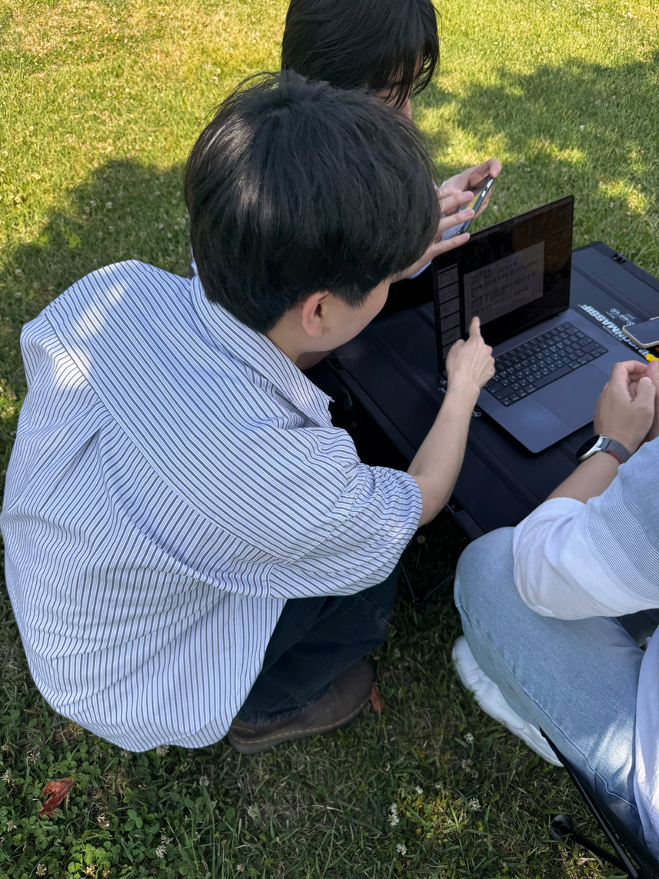
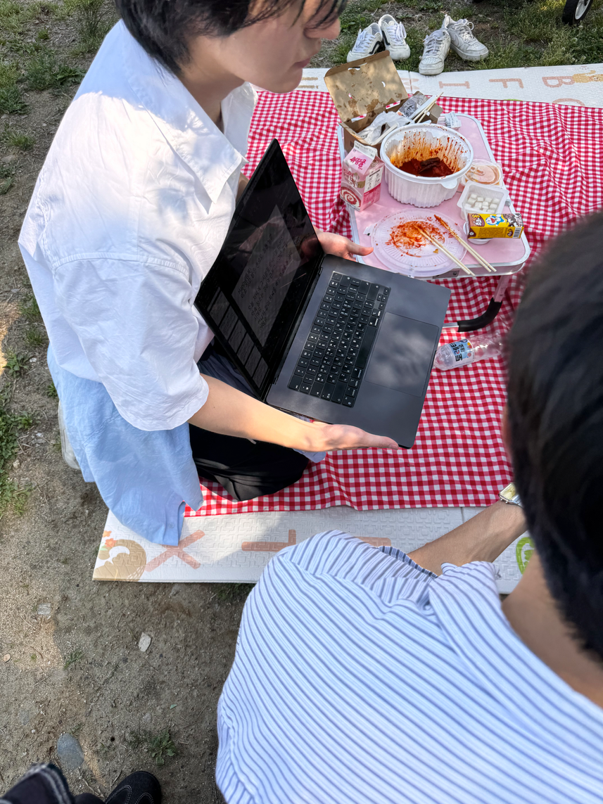
09
TIMELINE & CONTRIBUTIONS
Timeline & Contributions
PHASE 1 (5.11 - 5.24)
PHASE 2 (5.24~5.31)
PHASE 3 (5.24~5.31)
PHASE 4
Data & model design
Training (per-modality models)
App & sensing
Optimize & demo
준
준병
재
재웅
App design & engineering — UI, sensing pipeline, on-device inference, data preprocessing (mel-spectrogram, ML kit face detection)
Model Plan & training — per modality, accuracy analysis
Optimization - pruning & quantization.
We have collected for 35 participants!
(from class, outdoor, friends, etc)
10
Notes:
How we built it across four phases — data and model design, training, the app and sensing layer, then optimization and demo. Contributions: 재웅 led the model side — training the per-modality networks and the size and speed optimization. 준병 built the application — the Compose UI, the sensing pipeline (mic mel front-end, fingertip PPG, ML Kit face detection), and the on-device TFLite inference. One framing note: where the proposal said multimodal fusion, in practice it's per-modality models assembled per scenario, with the voice front-end carefully matched to training.

Slide 11
Thank You !
VOICE
FACE
PPG
DECEPTION
ON-DEVICE
박준병 & 최재웅 · MCA Final Presentation
11
Notes:
To close — Emotion Detector reads the truth beneath the surface: on-device, private by design, combining voice, face, and a fingertip pulse. The honest version of our story is that we scoped PPG down to a fingertip sensor in Blind Date, dropped facial rPPG, kept Interview to voice and face, and spent real effort making the on-device audio front-end faithful to training. Happy to take questions on the model, the sensing pipeline, or the accuracy trade-offs.

